Slide 1


PROJECT
Sprint Review
Turma B - Grupo 5
1170053 – Pedro Diniz
1211757 – Daniel Torres
1211759 – Diogo Veloso
1211765 – Gisela Araújo
1211779 – Márcio Carvalheiro
1211785 – Maurício Barros
1211788 – Patrick Rodrigues
1211797 – Tânia Mota
1211799 – Tiago Machado
1211801 – Valter Sousa

Slide 2
Product Backlog
1- Provide the actors ability to select data on Java application, when possible, using Data Transfer Objects
2- Restricts the instantiation of a DataManagement class to one single instance (Singleton Pattern)
3- Add user profile permissions validation (after implements user authentication)

Slide 3
Domain Model

Slide 4
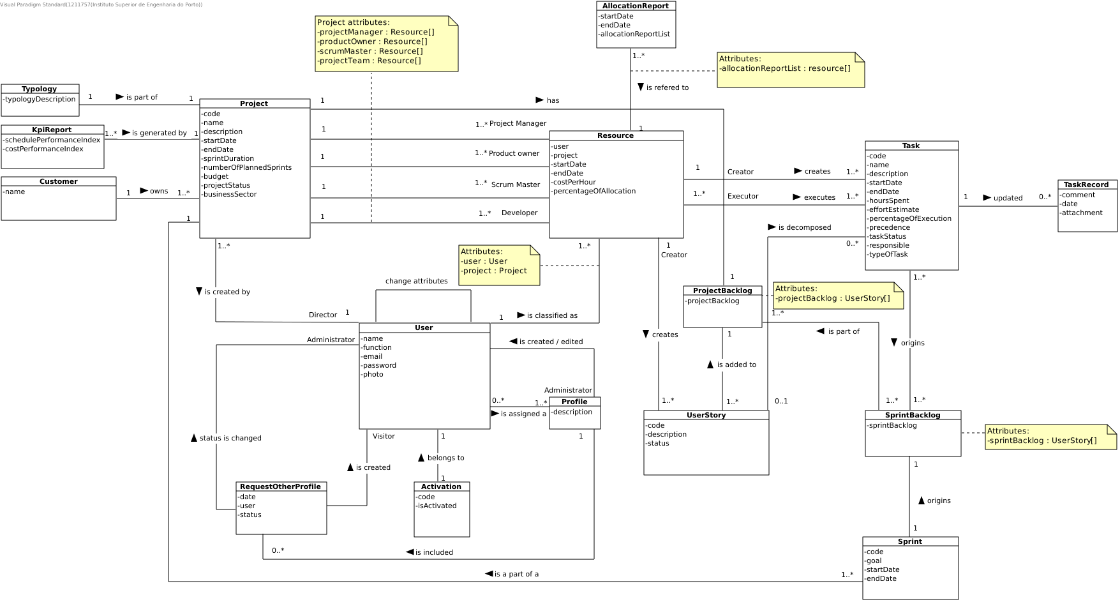

Slide 5
US01
As Non-Registered User, I want to register as an application user.
Author: valter sousa

Slide 6
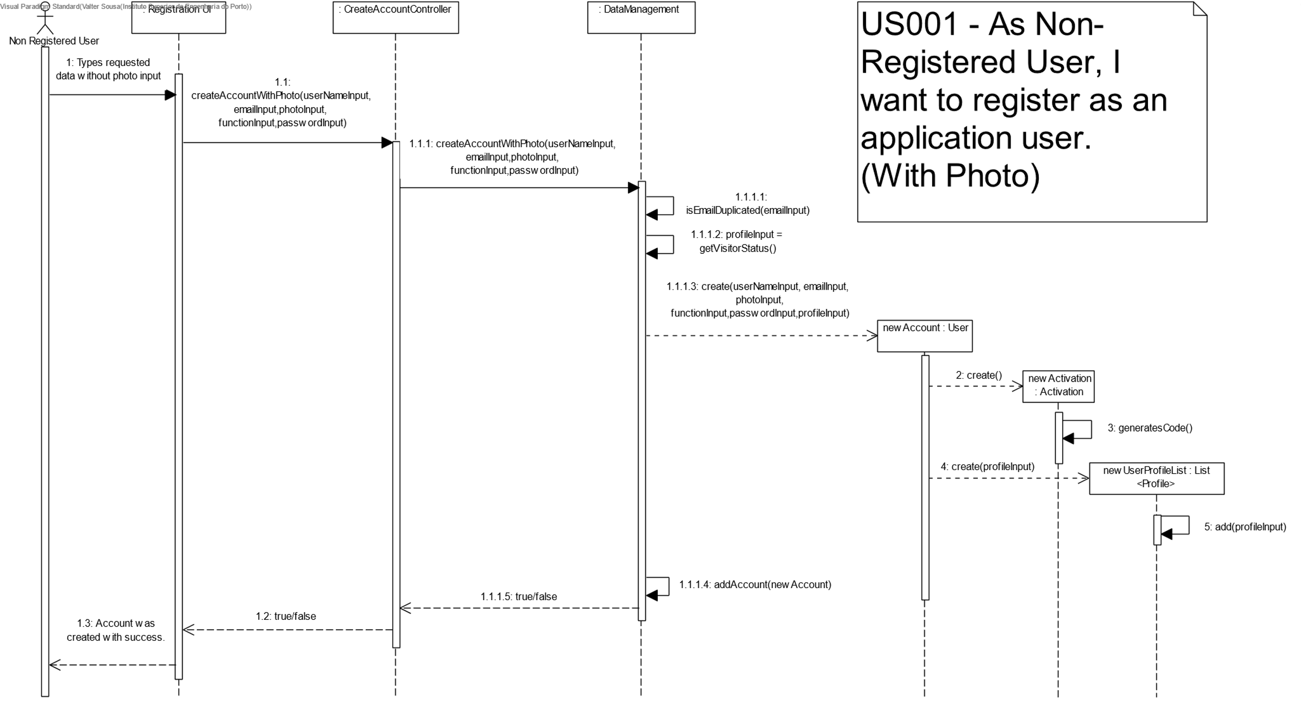

Slide 7
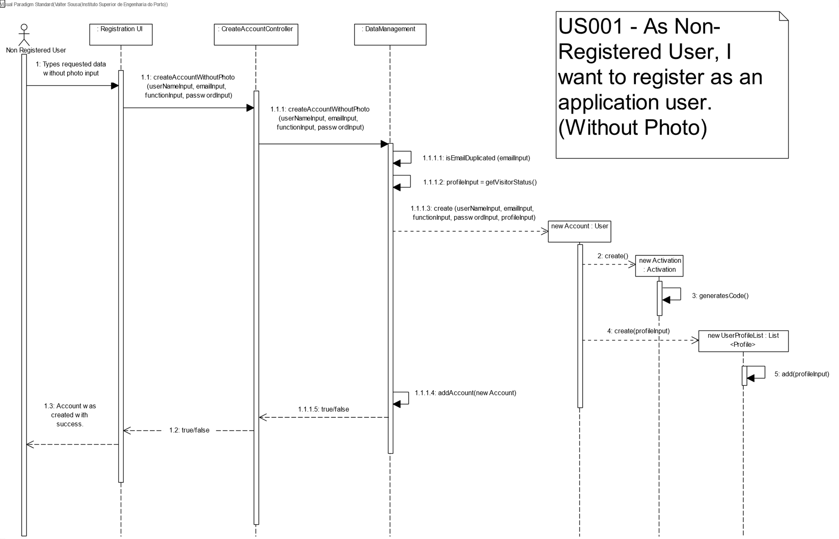

Slide 8
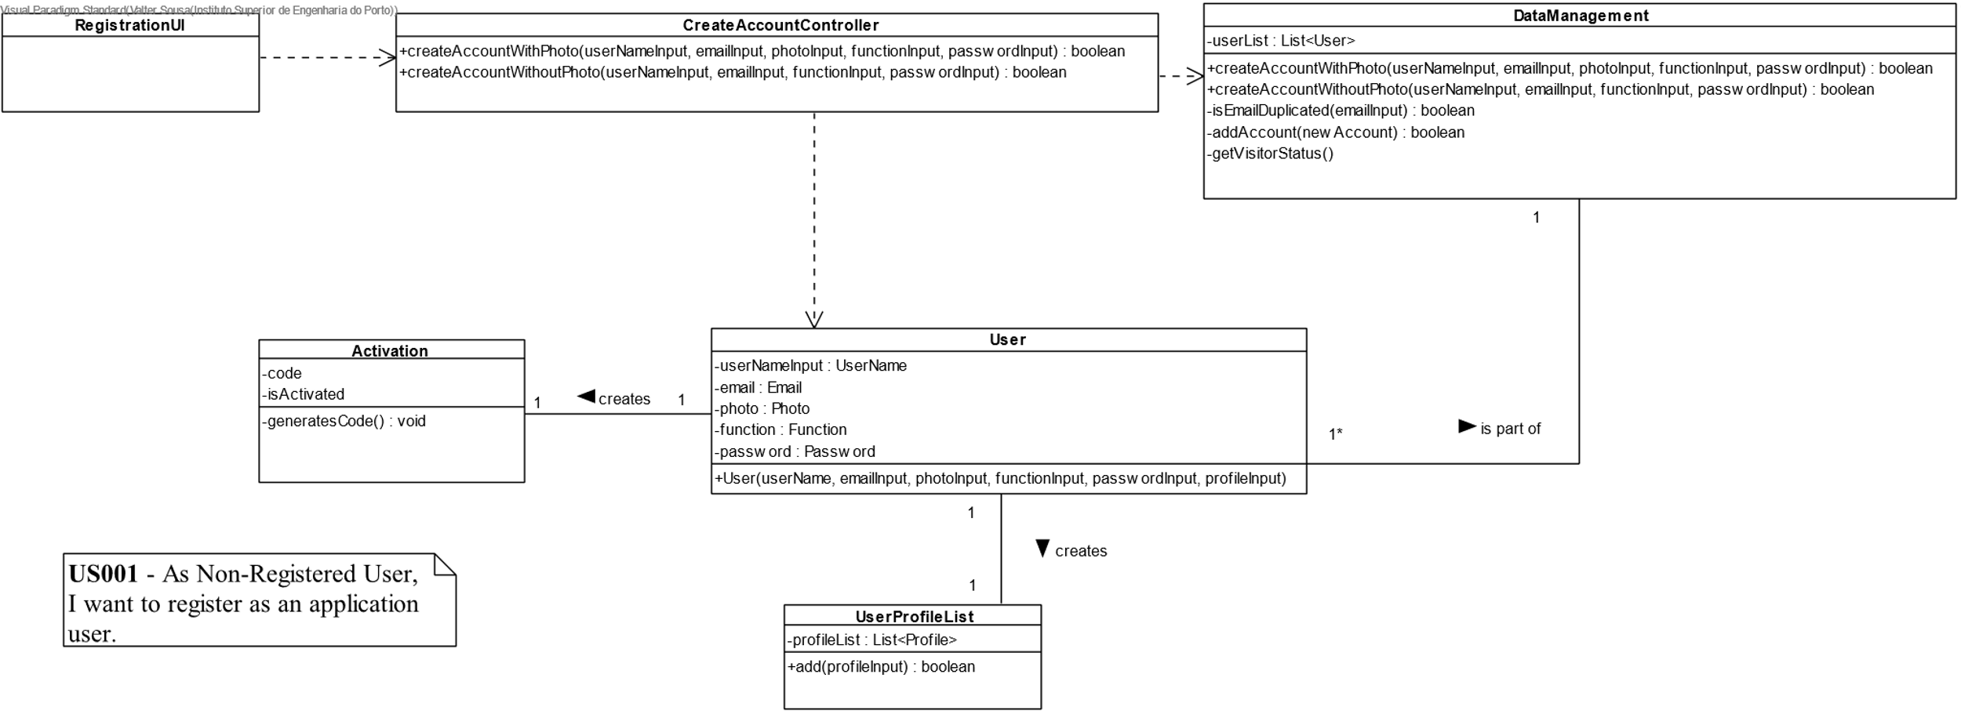

Slide 9
Unit Tests JUnit
DataManagementTest:
createAccountWithPhotoUnsuccessfullyDuplicatedEmail()
createAccountWithPhotoUnsuccessfullyInvalidName()
accountWithPhotoAddedToUserListSuccessfully()
createAccountWithPhotoSuccessfully()
createAccountWithoutPhotoUnsuccessfullyDuplicatedEmail()
createAccountWithoutPhotoUnsuccessfullyInvalidName()
accountWithoutPhotoAddedToUserListSuccessfully()
createAccountWithoutPhotoSuccessfully()

Slide 10
Unit Tests JUnit
As validações dos atributos foram feitas nas suas próprias classes:
UserNameTest
EmailTest
PhotoTest
FunctionTest
PasswordTest

Slide 11
US02
As Non-Registered User, I want to activate a just registered user account.
Author: Gisela Araújo

Slide 12
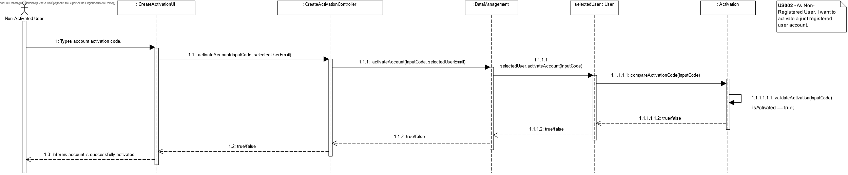
US 02 - Sequence Diagram

Slide 13
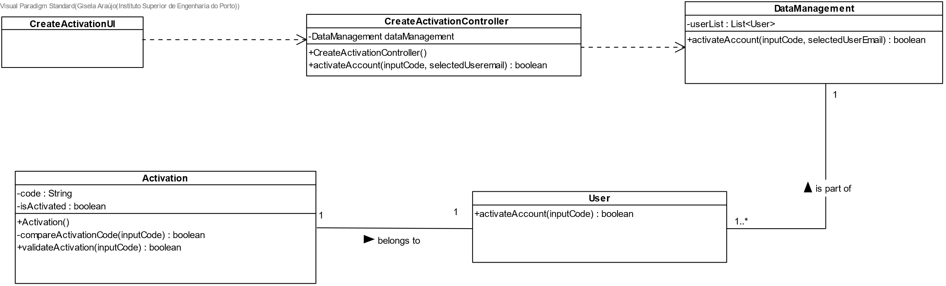
US 02 - Class Diagram

Slide 14
Unit Tests JUnit
ActivationTest
validInputCode()
invalidInputCode()
inputCodeEmpty()
inputCodeNull()
CreateActivationControllerTest / DataManagementTest / UserTest
activateAccount()
activateAccountIsInvalid()
activateAccountHasInputCodeEmpty()
activateAccountHasInputCodeNull()
Line coverage 100%
Mutation coverage 100%
Test strength 100%

Slide 15
US03
As Visitor, I want to send a request to the administrator to assign him/her a given profile.
Author: Márcio Carvalheiro

Slide 16
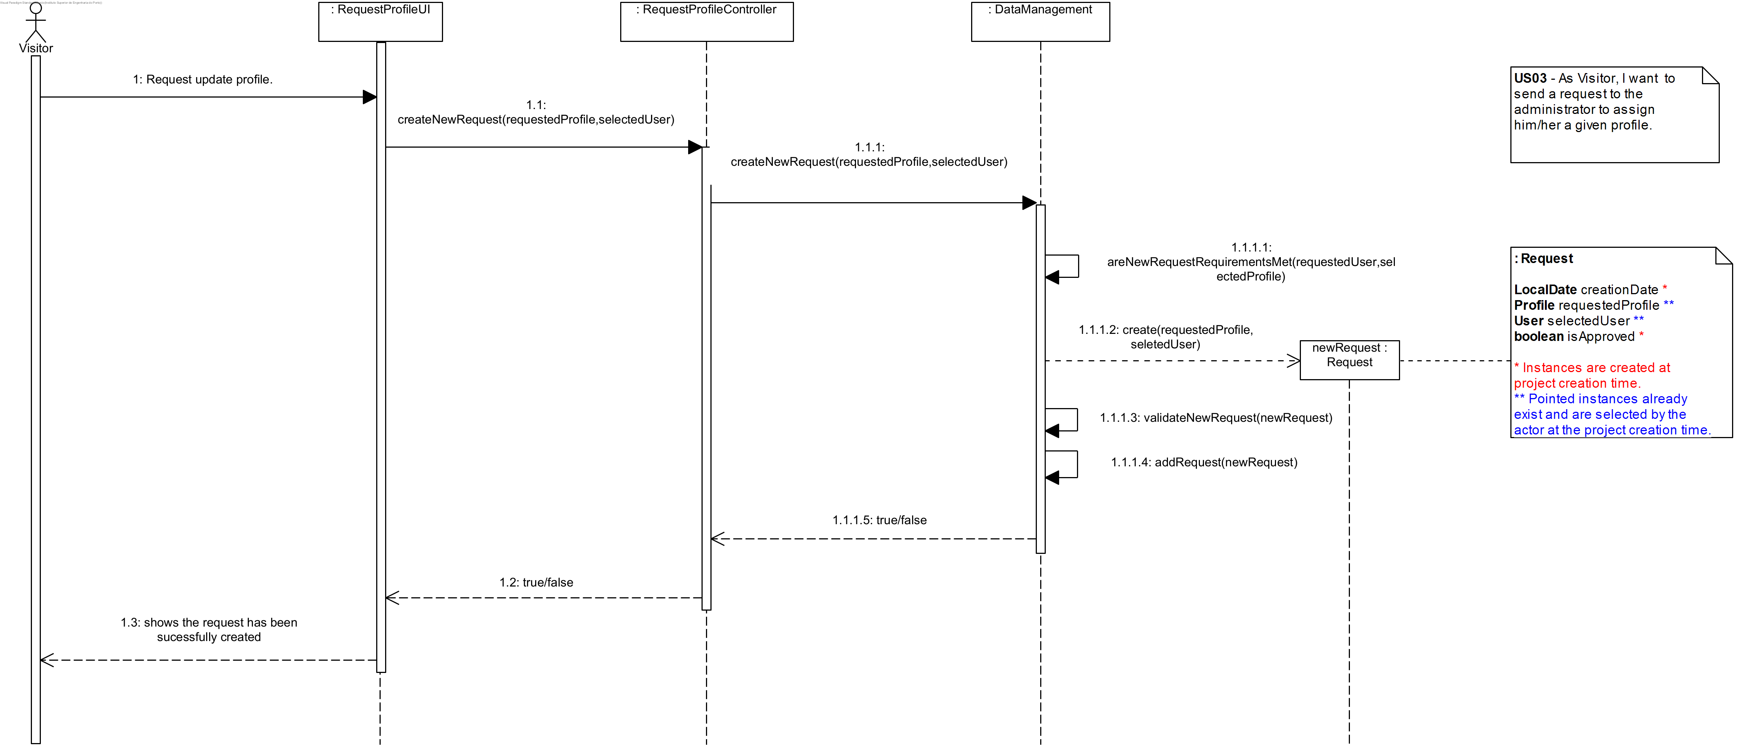
US 03 - Sequence Diagram

Slide 17
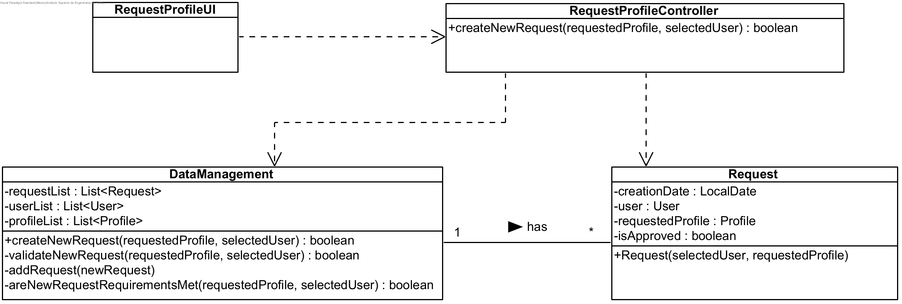
US 03 - Class Diagram

Slide 18
Unit Tests JUnit
Test 1: create a new Request that doesn’t exist in the system, returning true.
Test 2: try creating a duplicated Request, returning false.
Test 3: try requesting a Profile that doesn’t exist in the system, returning false.
Test 4 : try creating Request with an User that doesn’t exist in the system, returning false.
Test 5: try creating Request with an User that already has the requested profile, returning false.
Test 6: try creating Request with an User that doesn’t have the Visitor Profile, returning false.

Slide 19
US04
As Administrator, I want to search for users.
Author: Pedro Diniz

Slide 20
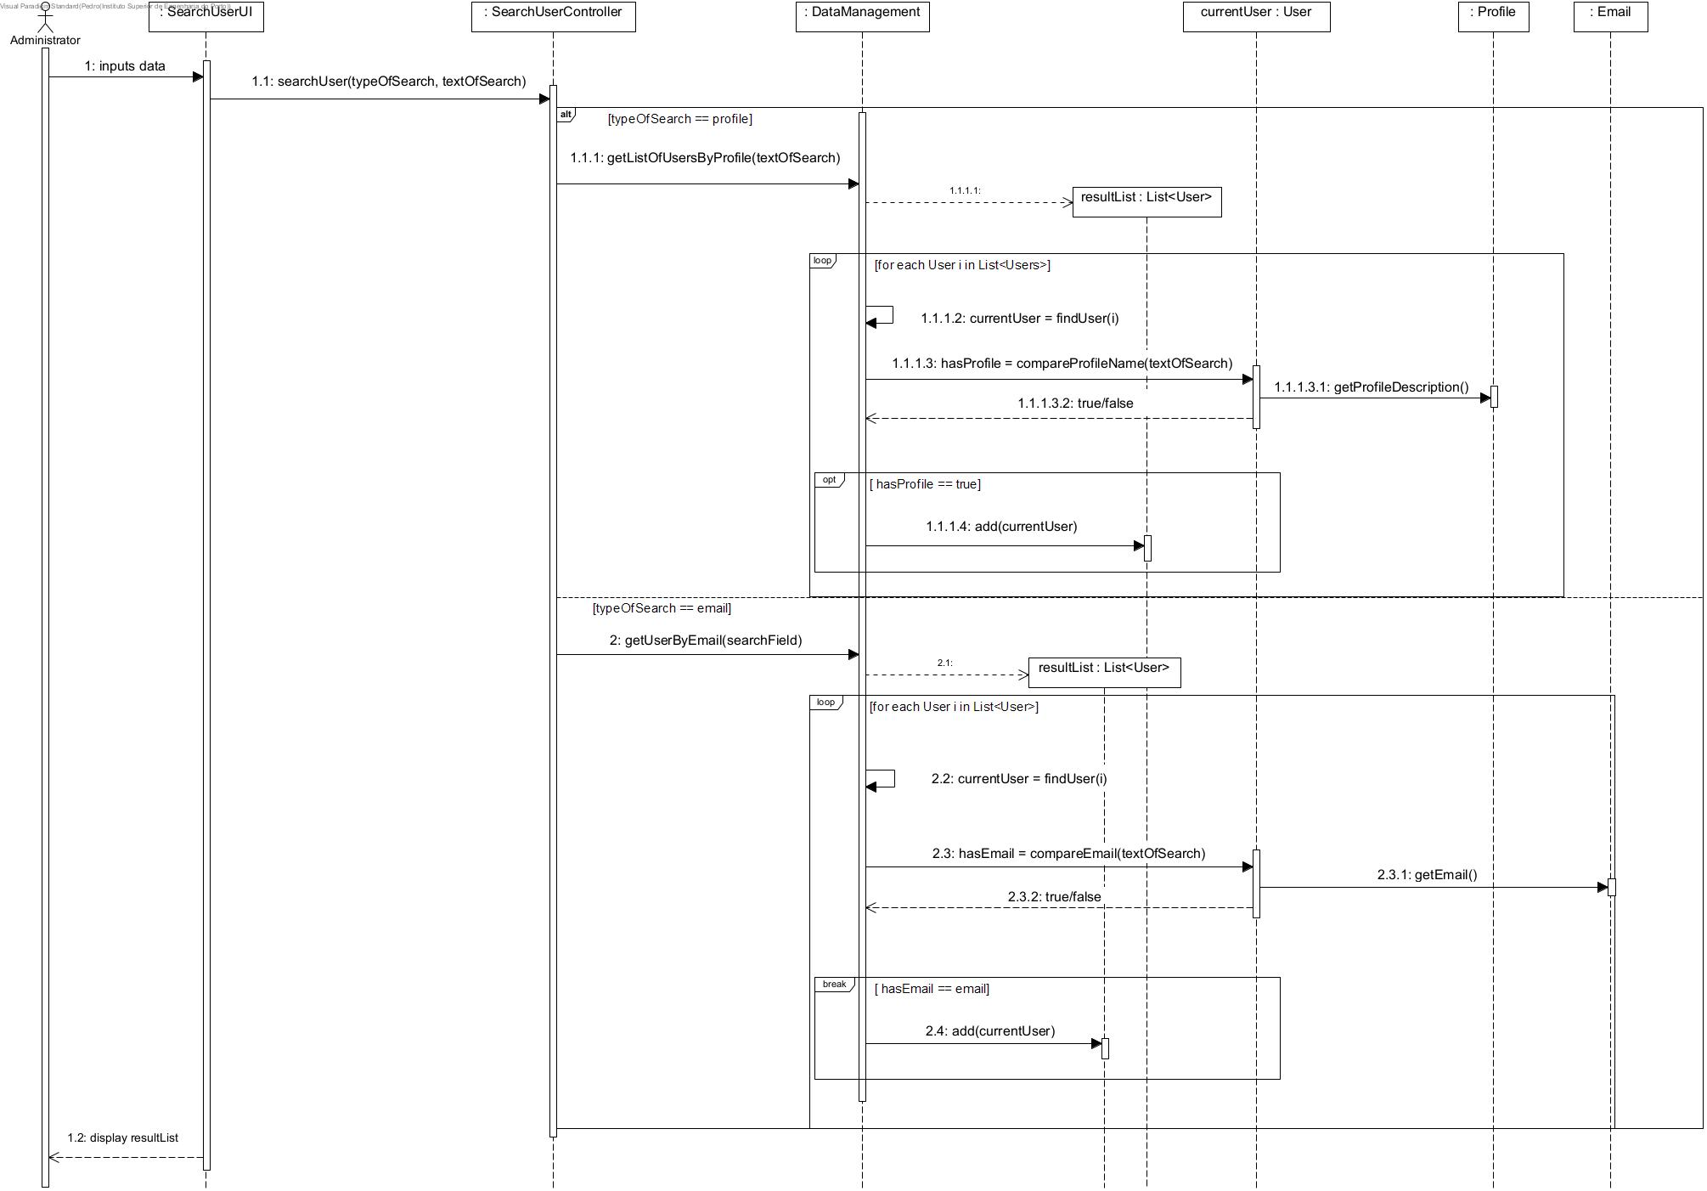
US 04 - Sequence Diagram

Slide 21
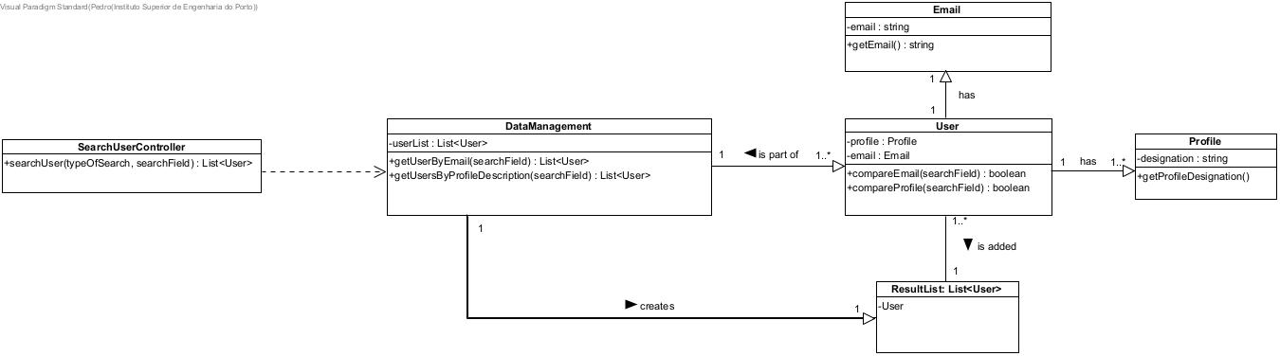
US 04 – Class Diagram

Slide 22
Unit Tests JUnit
Test 1: search an existing email, returning a list with that user.
Test 2: search by a not existing email, returning an empty list.
Test 3: search by an existing profile, returning a list with those users.
Test 4: search by a not existing profile, returning an empty list.
Test 5: inserting a random type of search and returning an empty list.

Slide 23
US05
As Director, I want to register/create a new project.
Author: Daniel dos Santos Torres

Slide 24
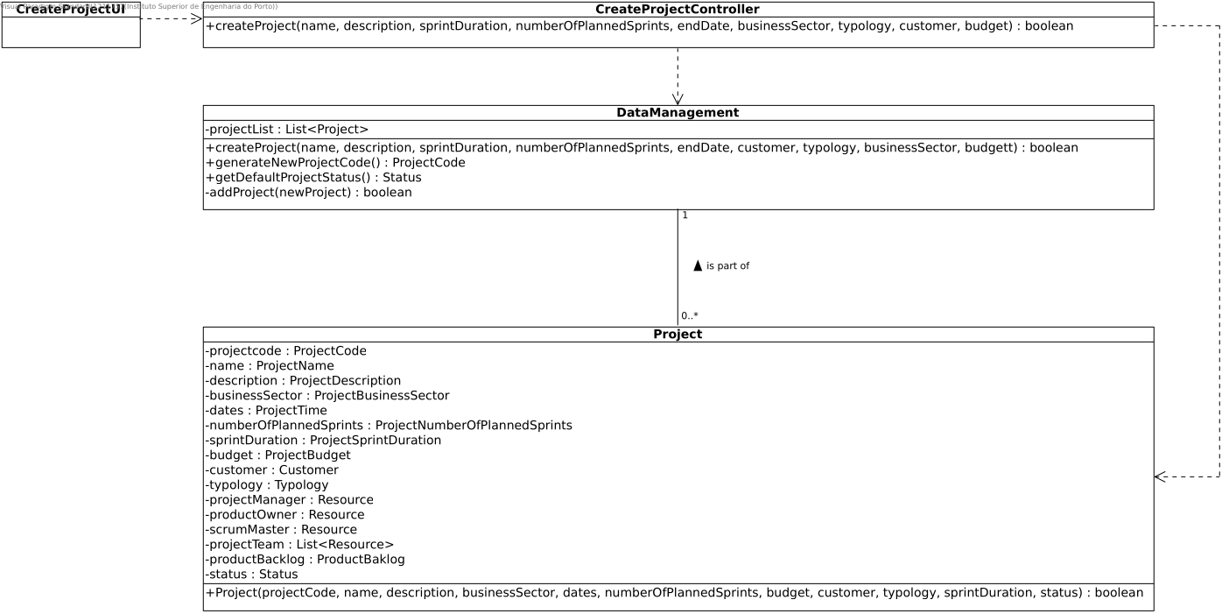

Slide 25
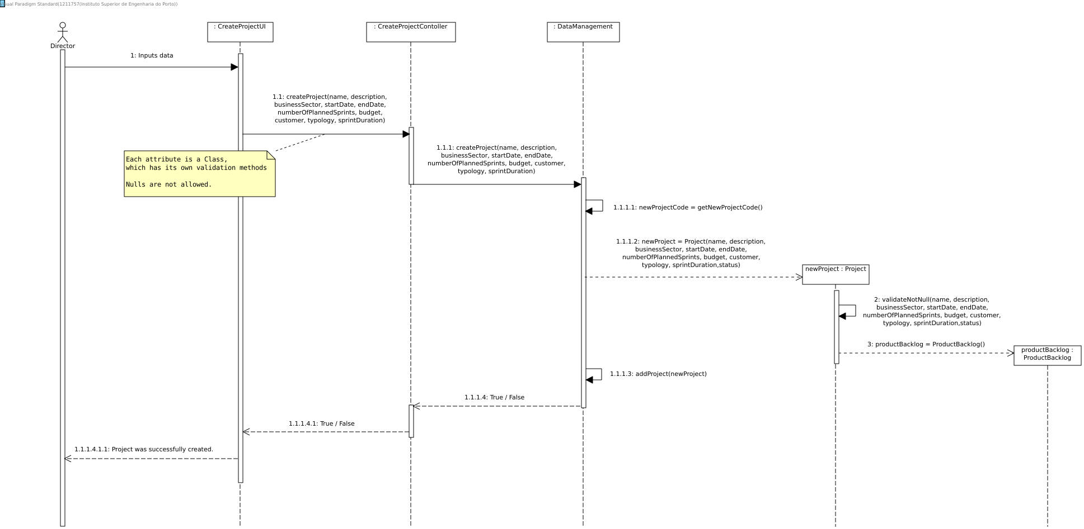

Slide 26
Unit Tests JUnit
ProjectTest
ProjectBudgetTest
ProjectBusinessSectorTest
ProjectCodeTest
ProjectDescriptionTest
ProjectNumberOfPlannedSprintsTest
ProjectTimeTest
StatusTest
TypologyTest
DataManagementTest
generatedProjectCodeExpectedForFirstProjectThisYearIsRight()
generatedProjectCodeExpectedForSecondProjectThisYearIsRight()
projectCreationFailsBecauseNullInputs()
projectCreationIsSuccessful()
secondProjectIsSuccessfullyCreated()
CreateProjectControllerTest
projectCreationIsSuccessful()
projectCreationFailsBecauseNullEntryInstance()
Line coverage 100%
Mutation coverage 100%
Test strength 100%

Slide 27
US06
As Administrator, I want to update profiles assigned to a user account.
Author: Pedro Diniz

Slide 28
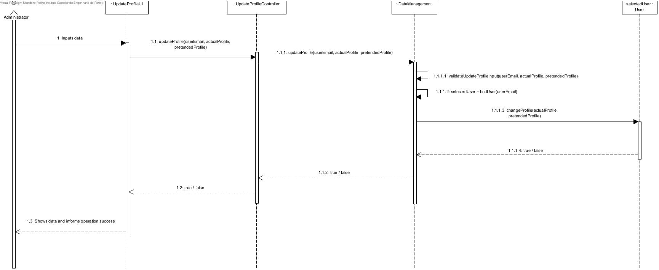
US 06 – Sequence Diagram

Slide 29
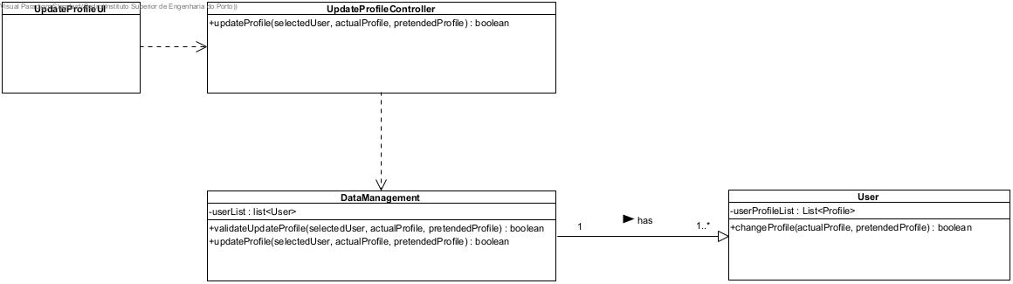
US 06 – Class Diagram

Slide 30
Unit Tests JUnit
Test 1: sucesfully updating a user’s profile for a new one.
Test 2: fail to update a user’s profile when user’s e-mail does not exist.
Test 3: fail to update a user’s profile when the user does not have the selected profile.
Test 4: fail to update a user’s profile when the pretended profile does not exist.

Slide 31
US07
As Director, I want to associate a human resource (user) to a project.
Author: pATRICK RODRIGUES

Slide 32
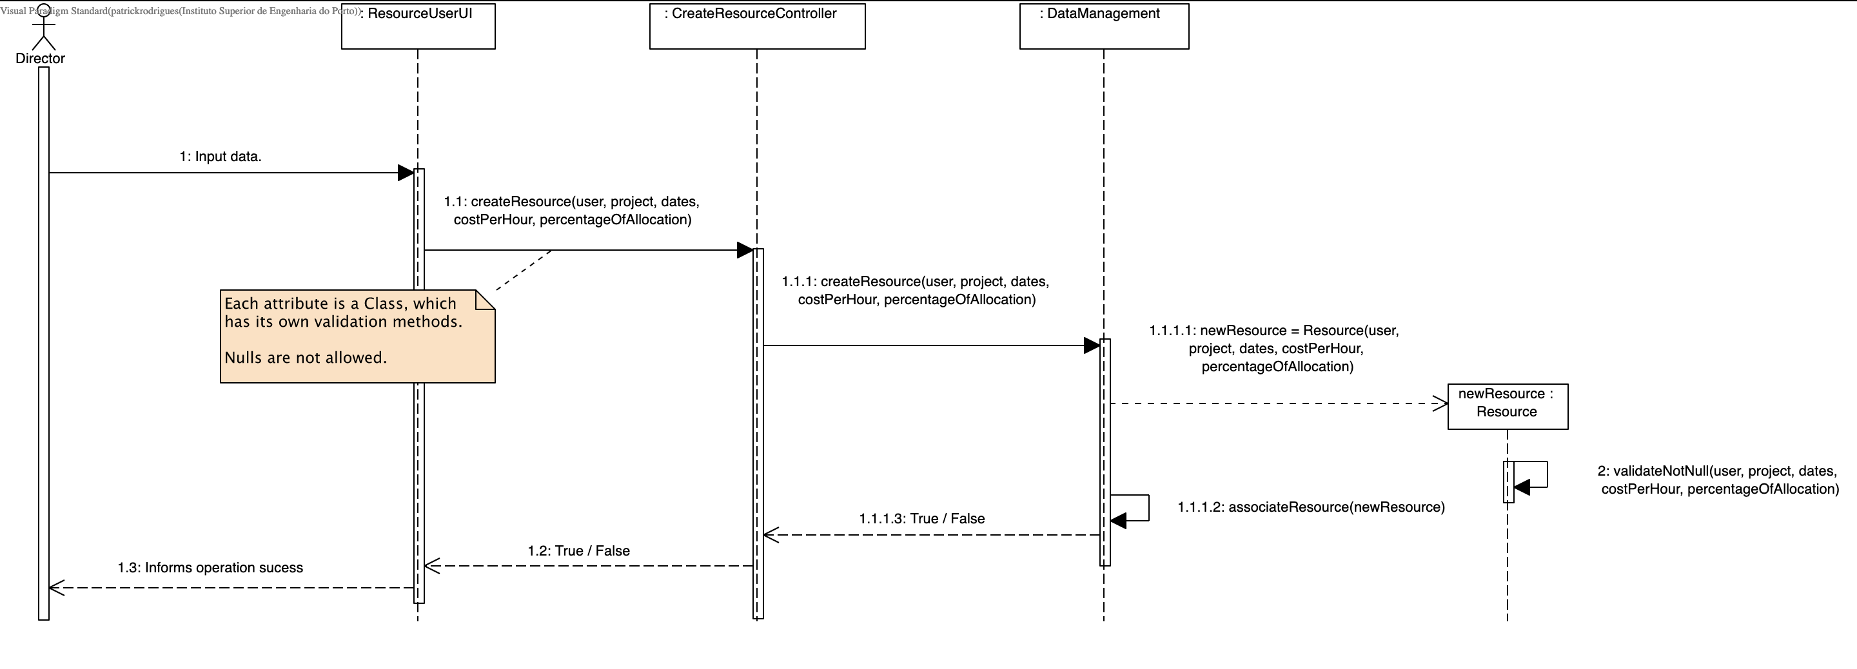
US 07 – Sequence Diagram

Slide 33
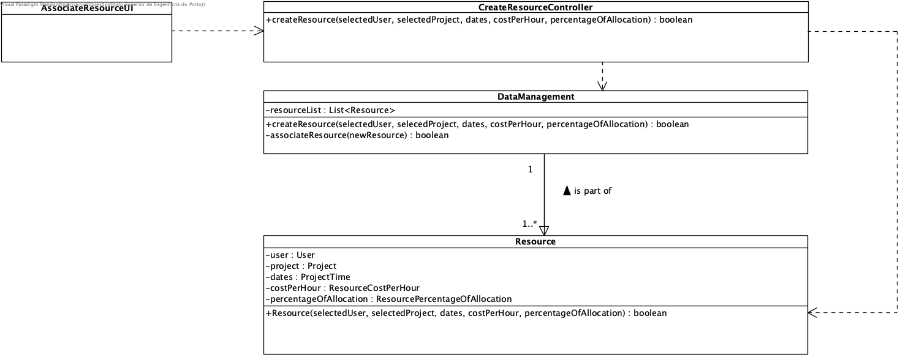
US 07 – Class Diagram

Slide 34
Unit Tests JUnit
ResourceCostPerHourTest
ResourcePercentageOfAllocationTest
ProjectTest
UserTest
ProjectTimeTest
DataManagementTest
resourceIsSuccessfullyCreated()
resourceFailsBecauseNullInput()
CreateResourceControllerTest
createResource()

Slide 35
US08
As Project Manager, I want to edit some project information.
Author: Maurício Pinto Barros

Slide 36
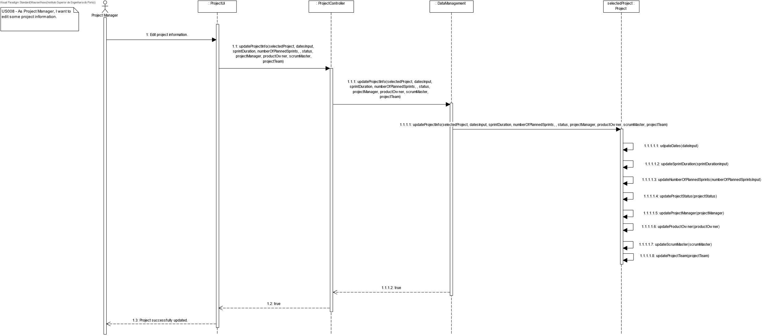
Us008 – Sequence Diagram

Slide 37
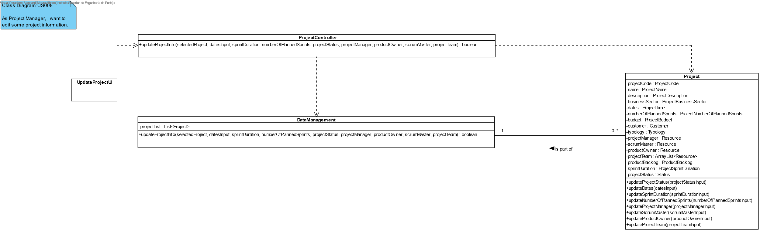
US008- Class Diagram

Slide 38
Unit Tests JUnit
DataManagementTest
- updateProjectInfoTest
- UpdateProjectInfoFailsBecauseNull
ProjectTimeTest
ProjectSprintDurationtTest
ProjectNumberOfPlannedSprintsTest

Slide 39
US09
As Product Owner, I want to create a user story and add it to the Product Backlog.
Author: Diogo Veloso

Slide 40
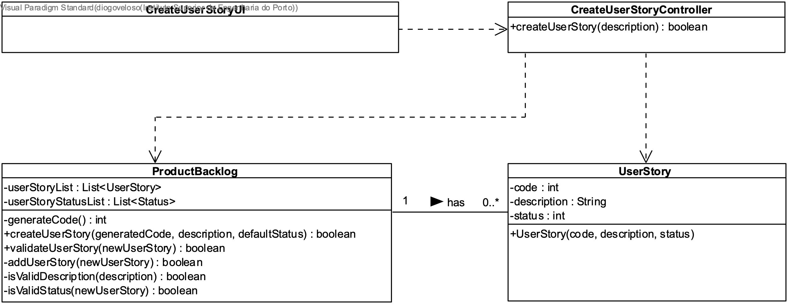
US 09 – Class Diagram

Slide 41
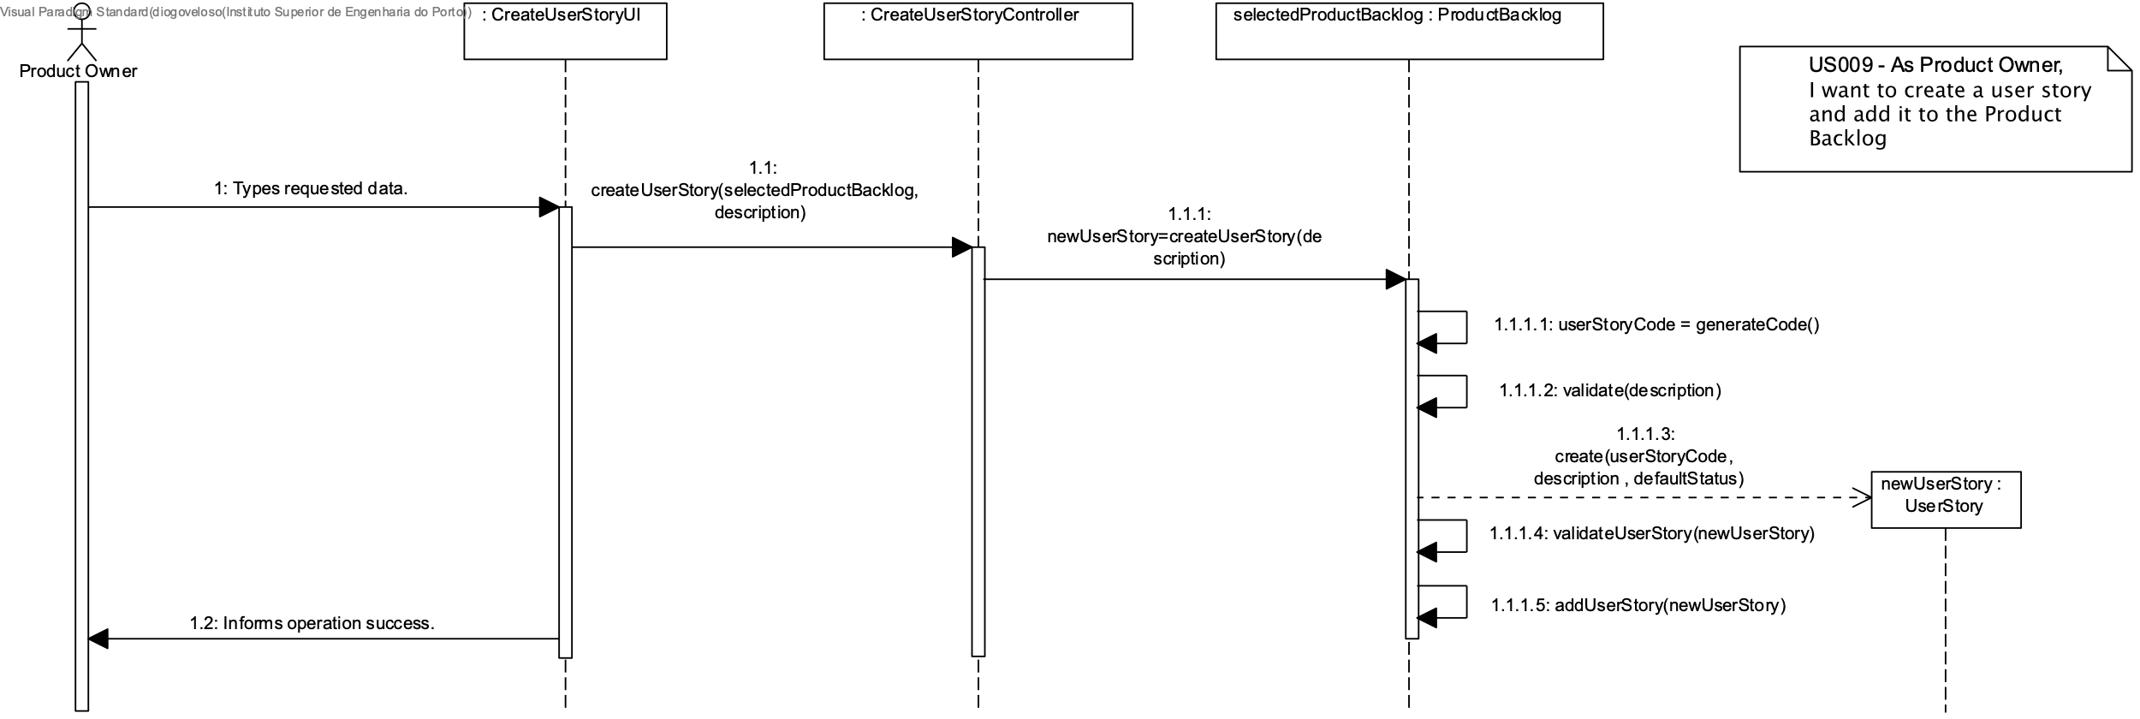
US 07 – Sequence Diagram

Slide 42
Unit Tests JUnit
UserStoryTest
Test1 : testUserStoryConstructorTrue()
ProducyBacklogTest
Test1 : createDifferentProductBacklog()
Test2 : createDifferentUserStoryInSameProductBacklogTrue()
Test3 : invalidDescriptionLargerThanOneHundredAndFifty()
Test4: invalidDescriptionSmallerThanOne()
Test5 : validDescription

Slide 43
US10
As Authenticated User, I want to update its own data (e.g., photo, function).
Author:TIAgo machado

Slide 44
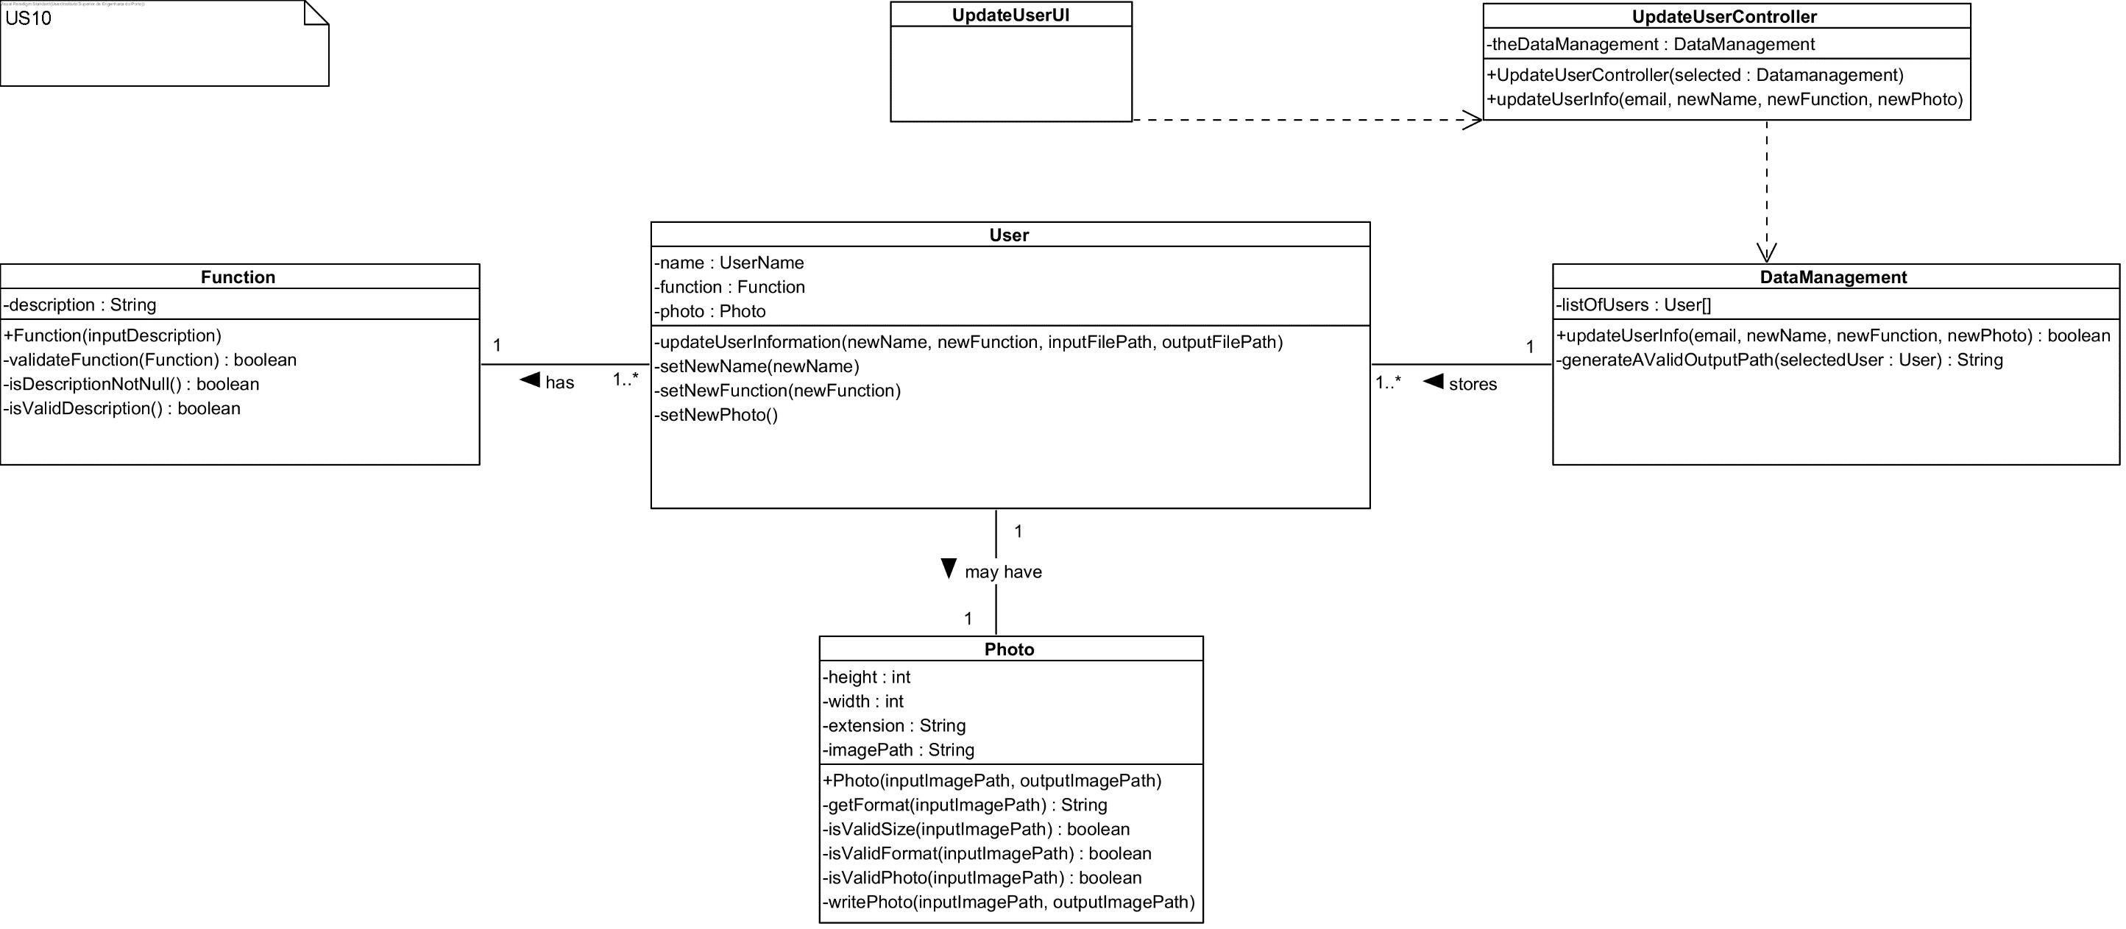
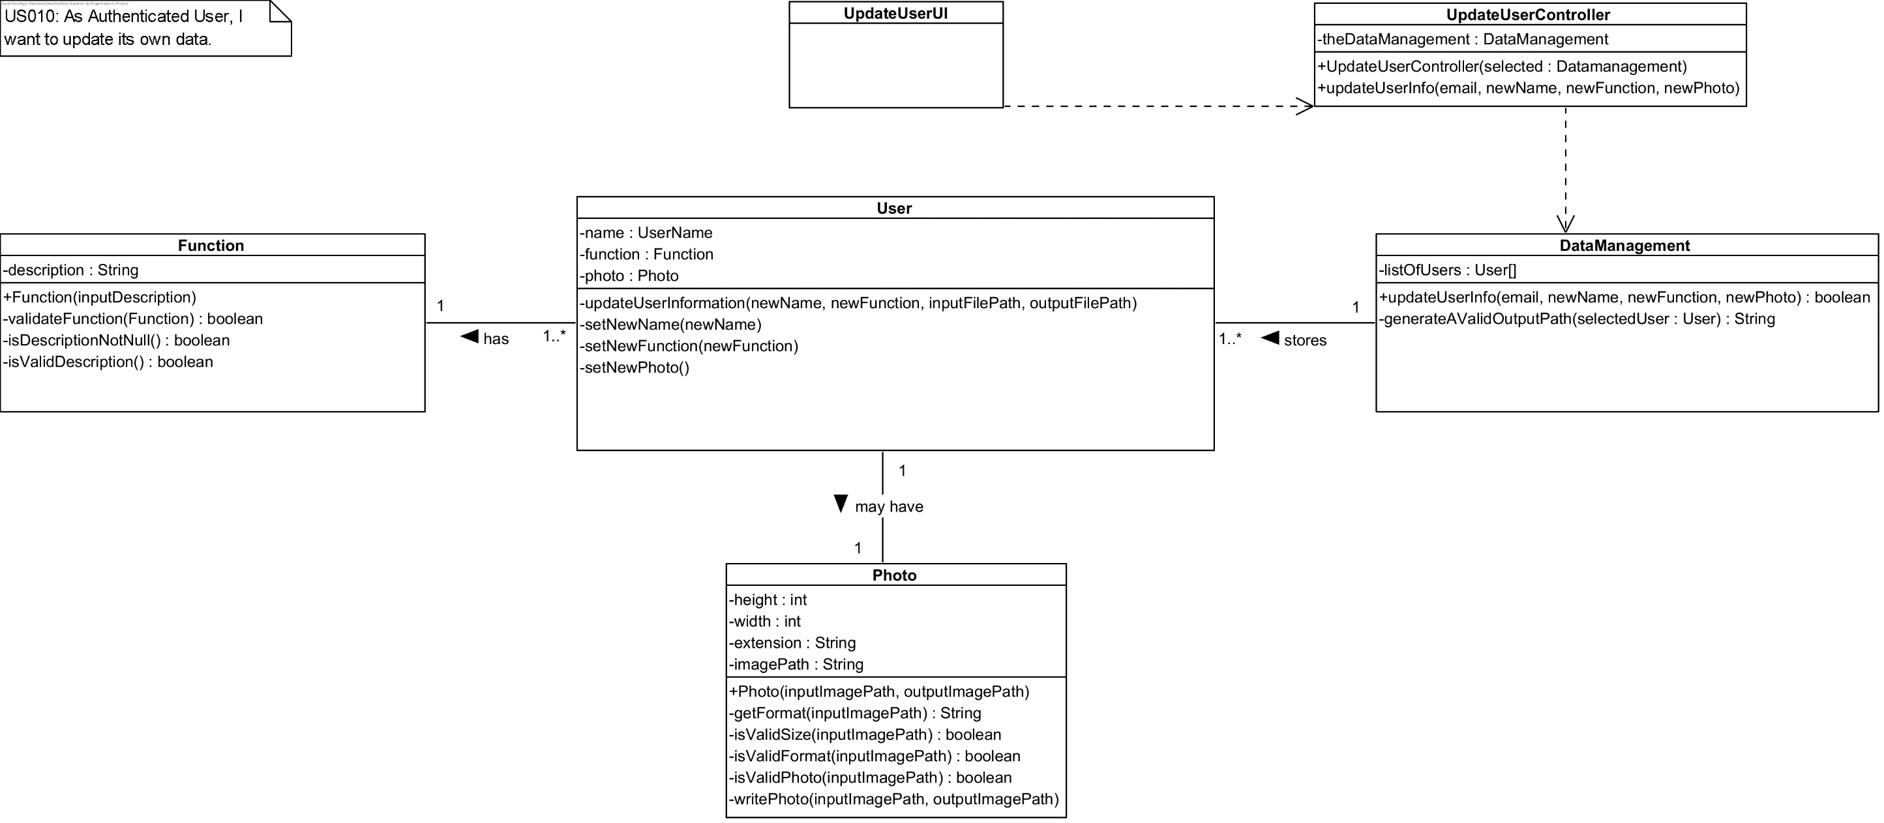

Slide 45
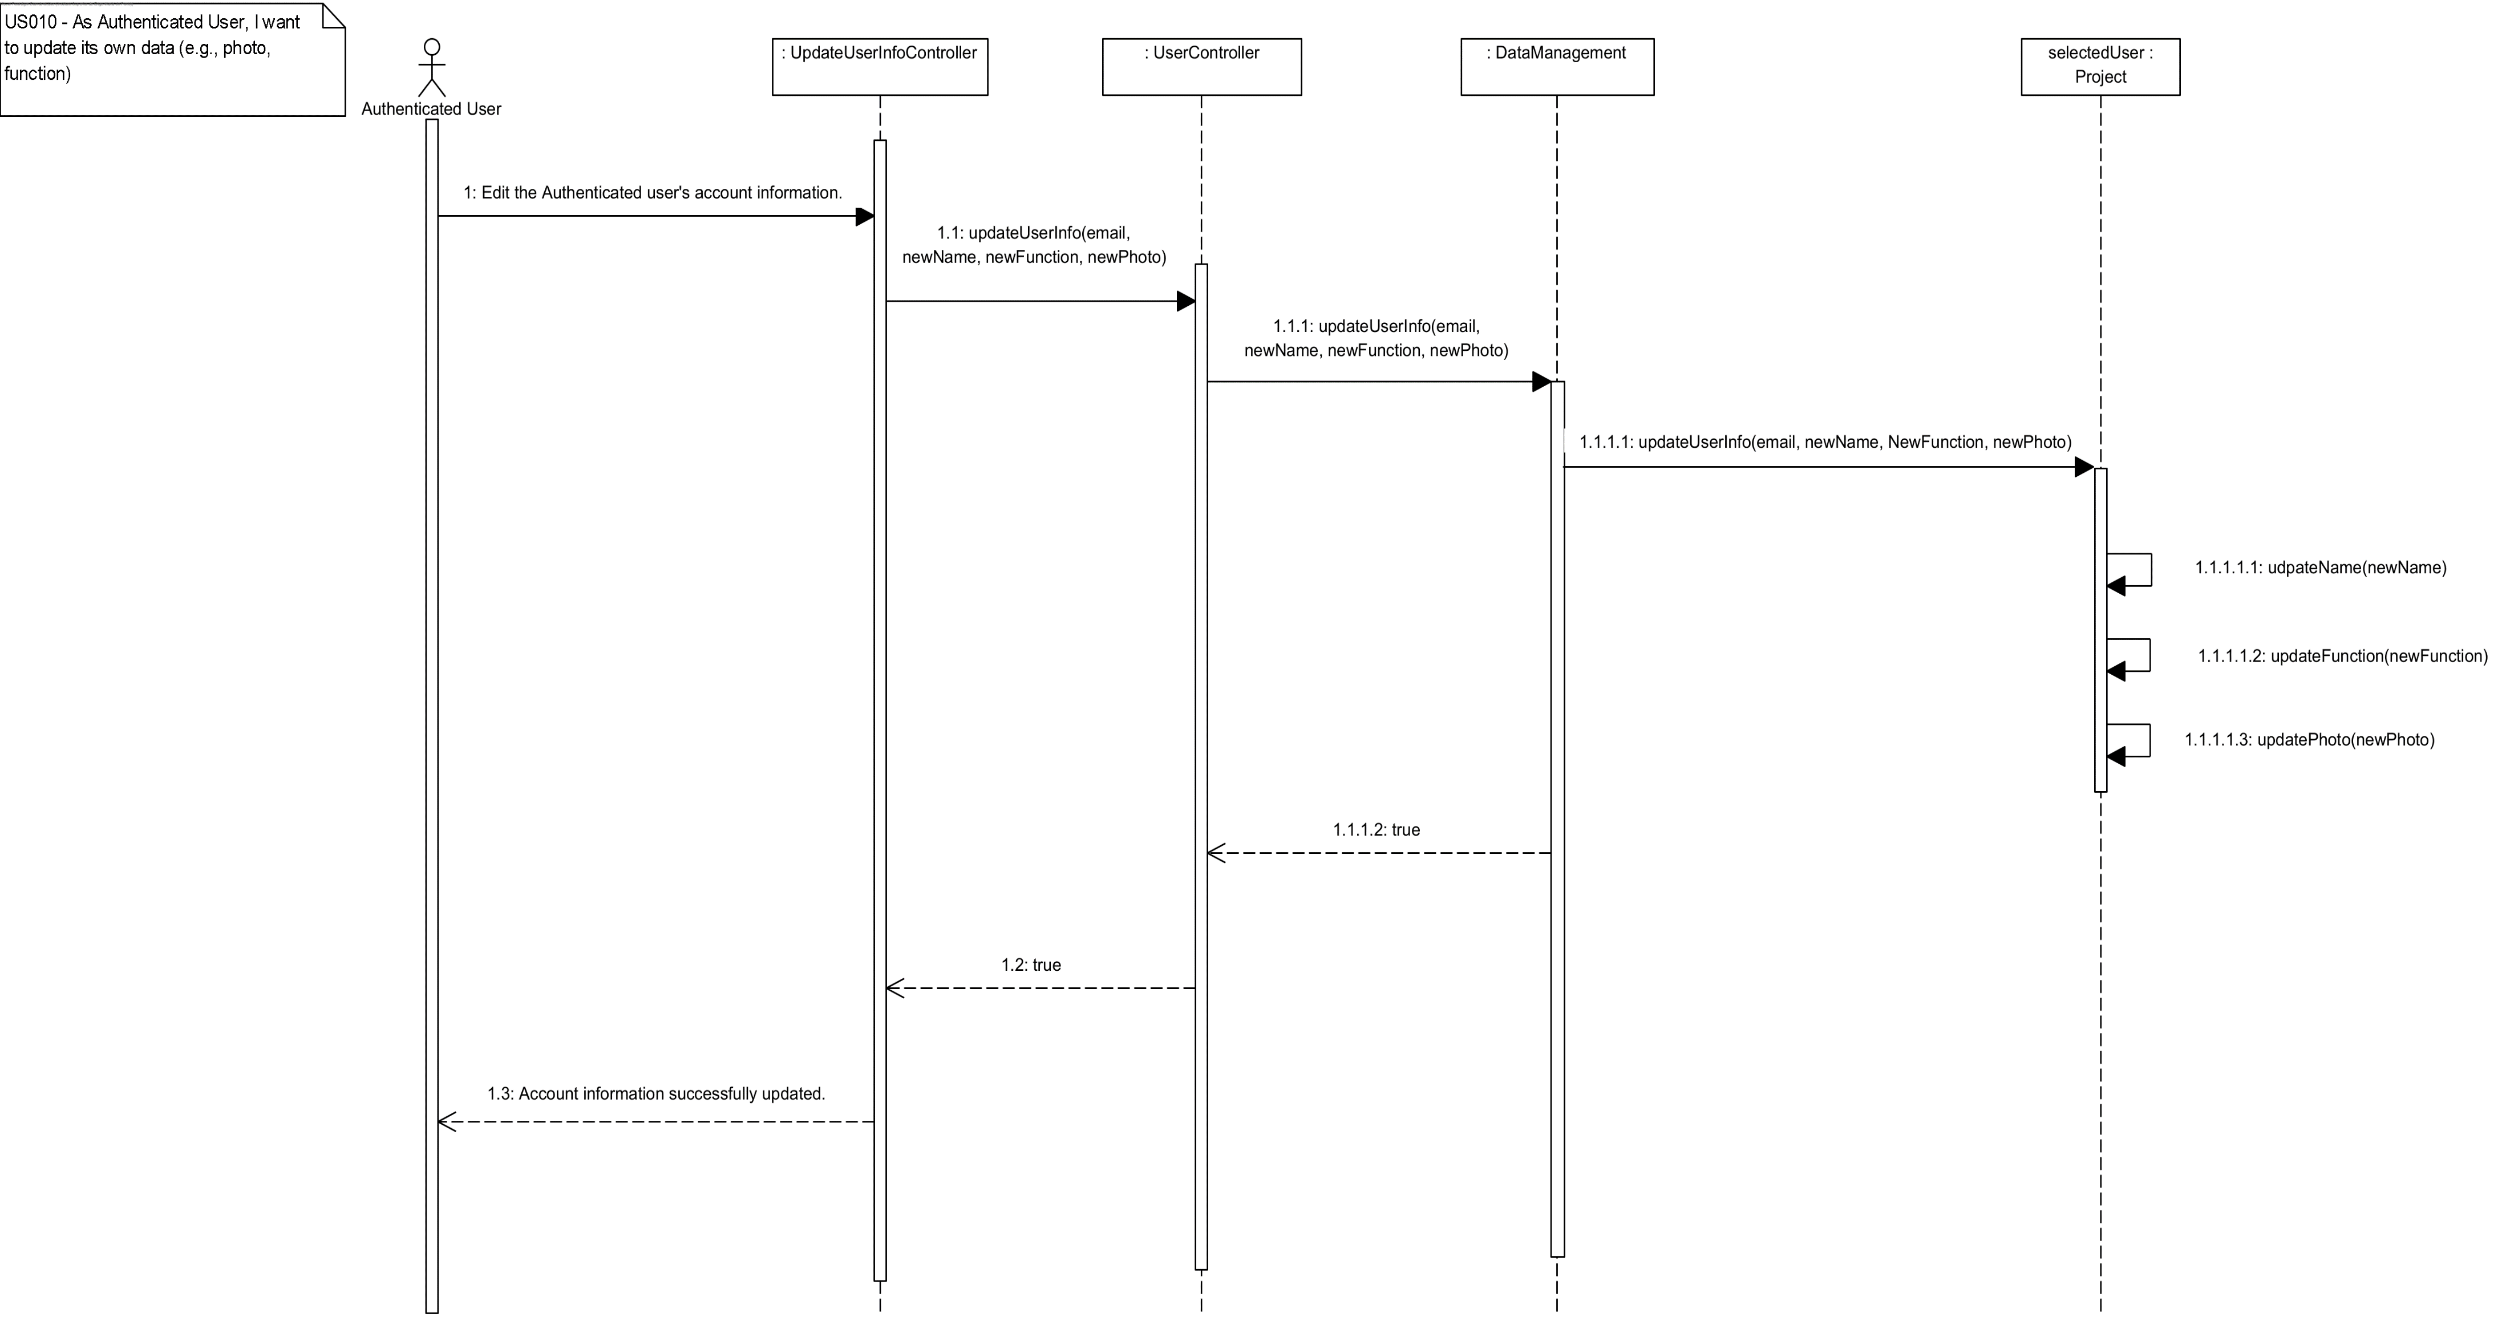

Slide 46
Código/Testes Realizados
Photo class:
Tested validation for:
Photo height (between 0 and 300 pixels);
Photo width (between 0 and 300 pixels);
Photo extension (either .png or .jpg);
Photo path (validates that the photo exists locally);
All parameters cannot be null;
Function class:
Tested validation for:
Function description must be a not null String;
Function description must be between 1 and 15 characters;

Slide 47
Código/Testes Realizados
User class:
Tested the updateUserInfo method with valid parameters and invalid parameters, all working as expected.
DataManagement class:
Tested:
the creation of a valid and unique path for each user’s Photo;
the existence of the email provided;

Slide 48
US11
As Authenticated User, I want to change his/her password.
Author: Tânia Mota

Slide 49
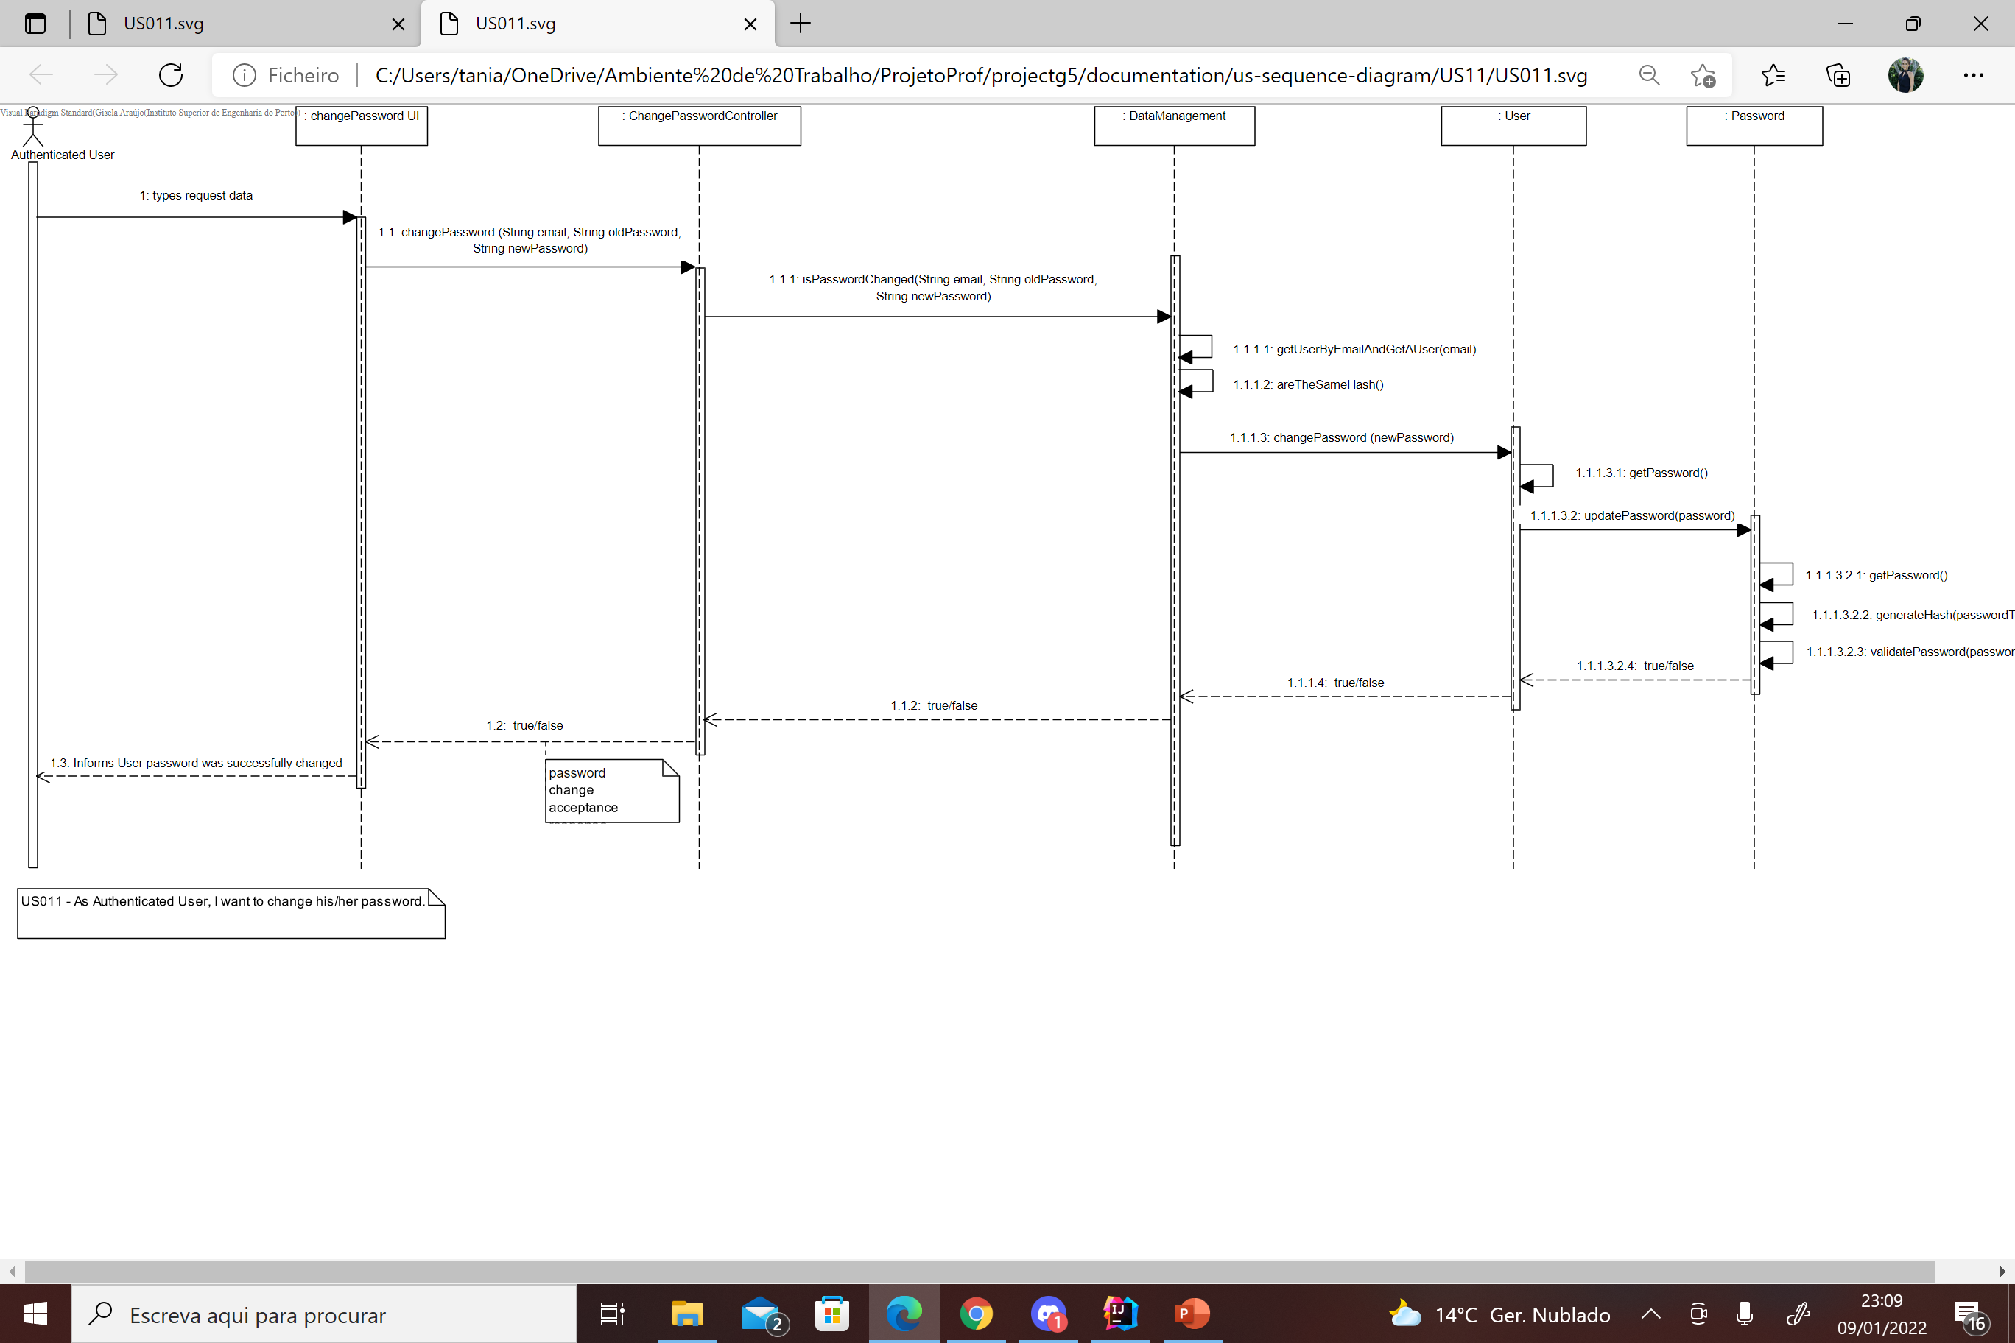
US 011 – Sequence Diagram

Slide 50
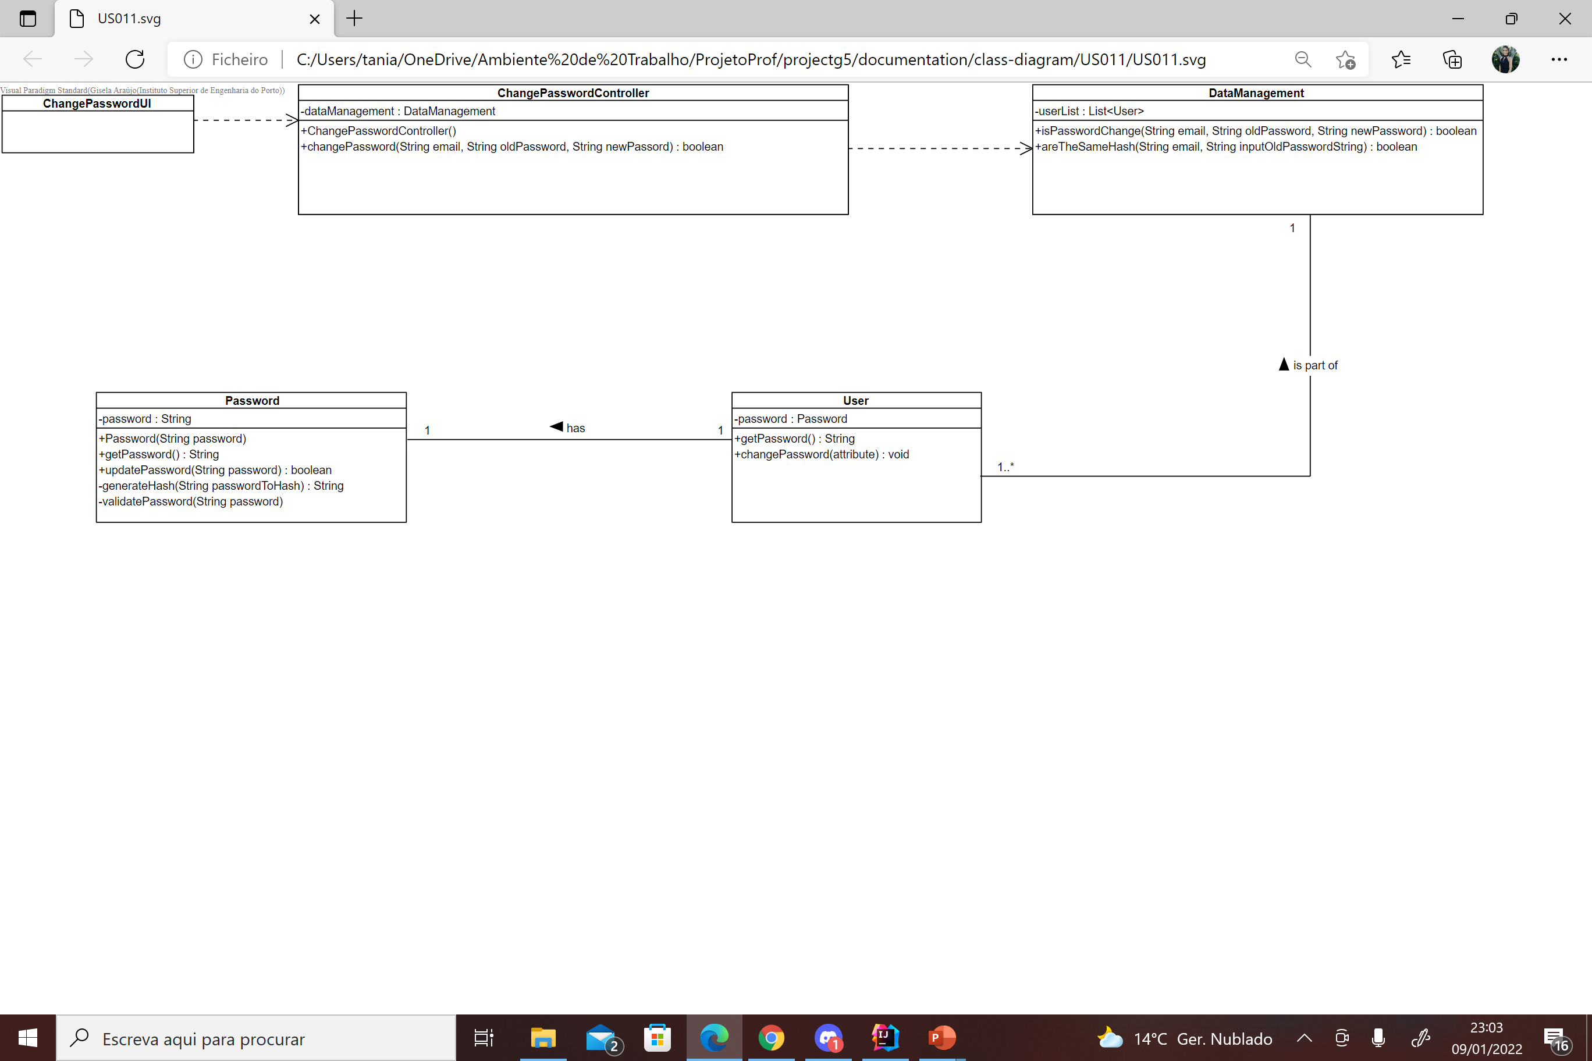
US 011 – Class Diagram

Slide 51
Unit Tests JUnit
UserTest
testGetPassword()
PasswordTest
testPasswordTooShort()
testPasswordTooLong()
testEmptyPassword()
testNullPassword()
testValidPassword()
testGetPassword()
testInvalidPasswordException()
DataManagementTest
testChangePassword()
testEmptyPasswordNotChanged()
testNullPasswordNotChanged()
ChangePasswordController
testChangePassword()

Slide 52
US12
As Director, I want to create a new project typology.
Author: Daniel dos Santos Torres

Slide 53
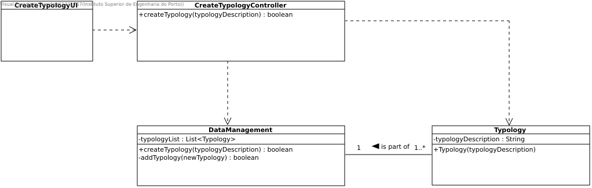

Slide 54
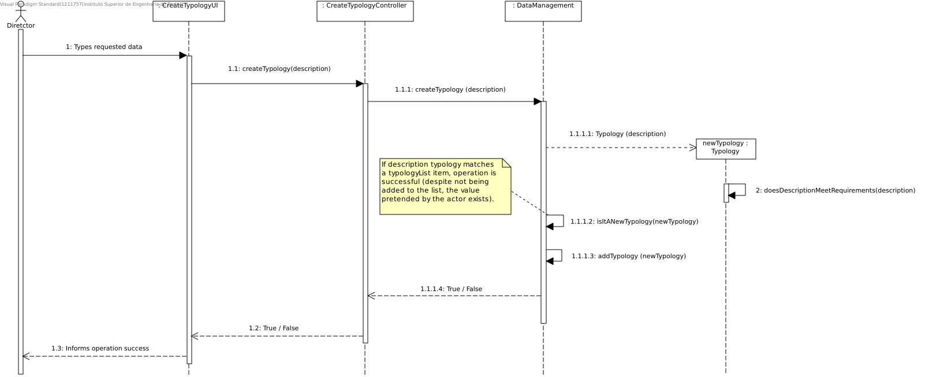

Slide 55
Unit Te
TypologyTests
typologyInputContainsInvalidCharacters()
typologyInputIsNotValidAboveUpperLimit()
Line coverage 100%
Mutation coverage 100%
Test strength 100%

Slide 56
US13
As Administrator, I want to create user profiles.
Author: Márcio Carvalheiro

Slide 57
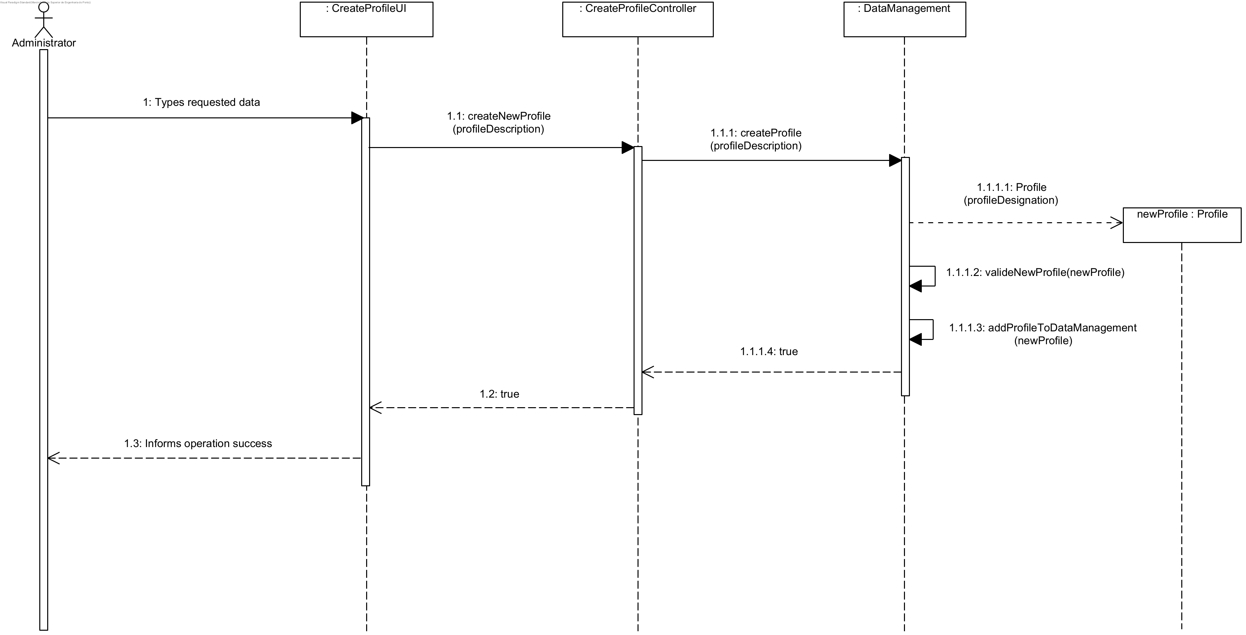
US 13 - Sequence Diagram

Slide 58
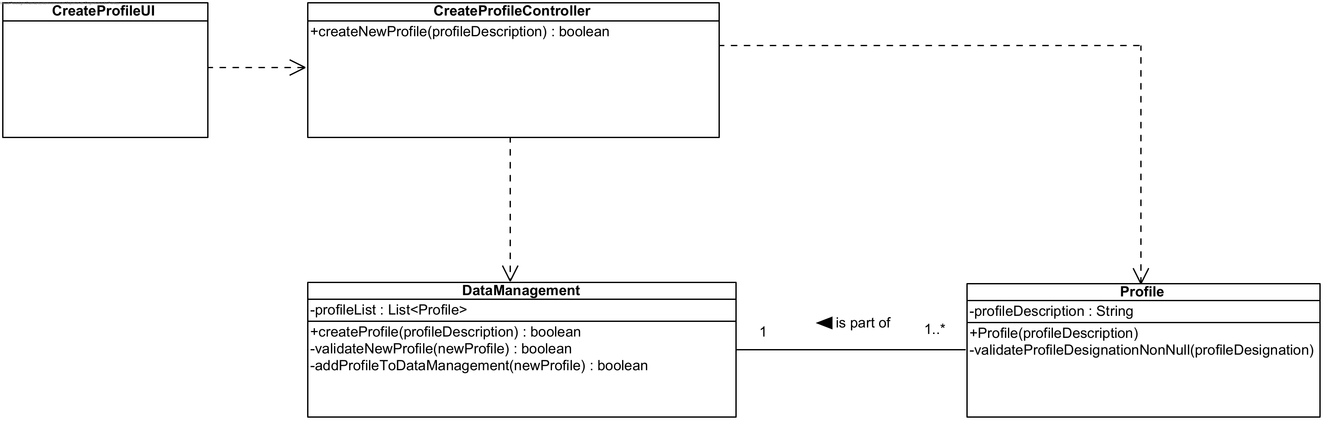
US 13 - Class Diagram

Slide 59
Unit Tests JUnit
Test 1: create a new Profile that doesn’t exist in the system, returning true.
Test 2: try creating a duplicated Profile in the system, returning false.

Slide 60
Retrospective
Easy communication between team members;
Focus on goals and results;
Everyone contributes their fair share;
Offer each other support;
Organized;
And we have fun while working;
Difficulties: covid-19 and working online, problems with git while working simultaneously online.

